Slide 1


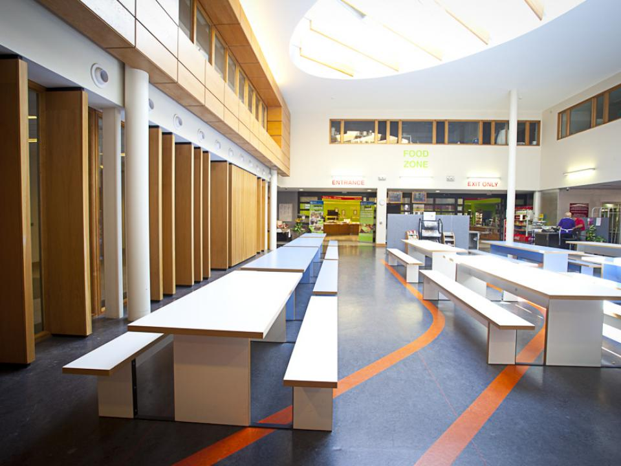
CANTEEN
ON THE GO
Presented by: Patryk Milkiewicz

Slide 2
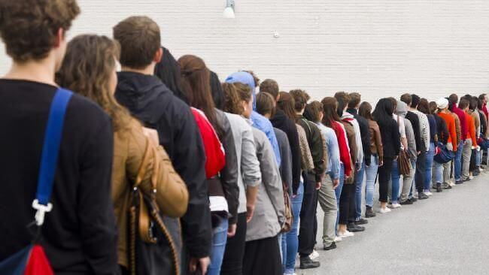
PROJECT DESCRIPTION
What?
Cashierless
Seamless
Why?
How?
Queues
RFID Technology

Slide 3
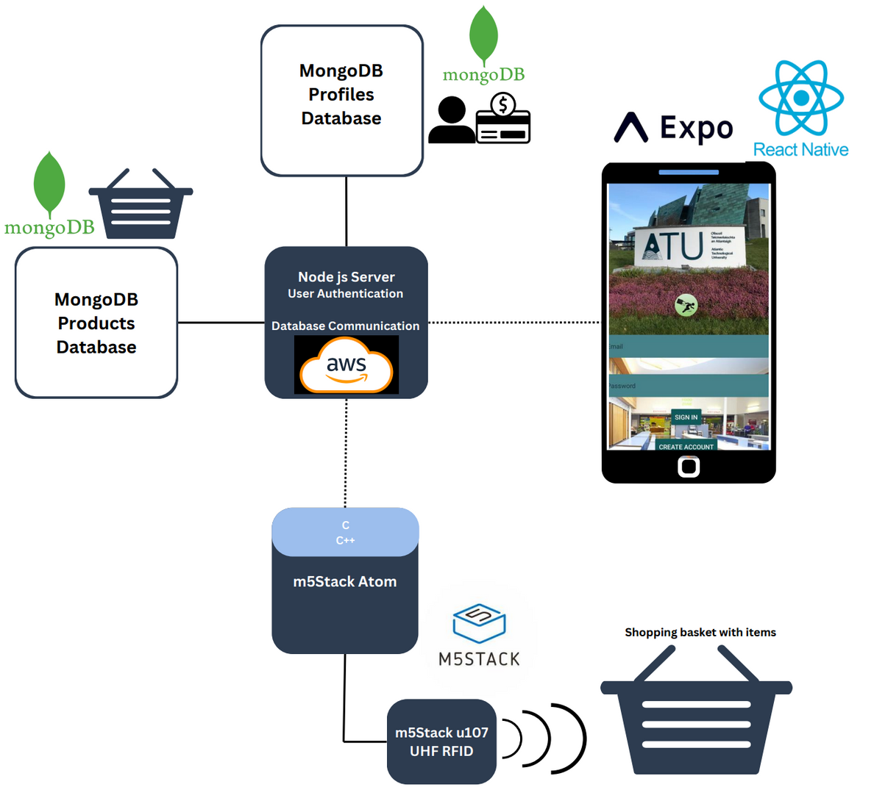
Architecture Diagram

Slide 4







Tools & Technologies
Easy to use and highly productive JavaScript Framework
Server Side
React Native
M5Stack UHF RFID u107
NoSQL
Flexible
Scalable
M5Atom Matrix
Hardware
Amazon Web Services
Mongo
For security
User Authentication
Bcrypt
JSON Web Token
Notes:
Node js as my runtime environment to run JavaScript code on my server side
Bcrypt for hashing passwords and storing the securely
ReactNative is used for building mobile applications using JavaScript and React and it allows to create cross-platform apps that have a native look and feel
MongoDB is a document-oriented NoSQL database that stores data in flexible, JSON-like documents which is known for its scalability, flexibility, and ease of use
JSON Web Token: which is a compact, URL-safe means of representing data between server and client side

Slide 5



SECURITY
Bcrypt for password encryption
JSON Web Token for user authentication
POST Requests
Notes:
Bcrypt is a cryptographic hashing function used for securely storing passwords by generating a hashed representation of the password string
it is intentionally slow and computationally expensive, making it resistant to brute-force attacks
JSON Web Token is used for authentication and authorization of users, it securely transmits information between my client and server side.
it contains a
Header: specifies the type of token and hashing algorithm used to create the signature
Payload: the user information
Secret Key: which is used to sign the token to ensure it hasn't been tampered with
POST requests typically send data in the request body, which is not visible in the URL like with GET requests. This means sensitive information, such as passwords or user details, is less likely to be exposed in server logs or browser history.

Slide 6
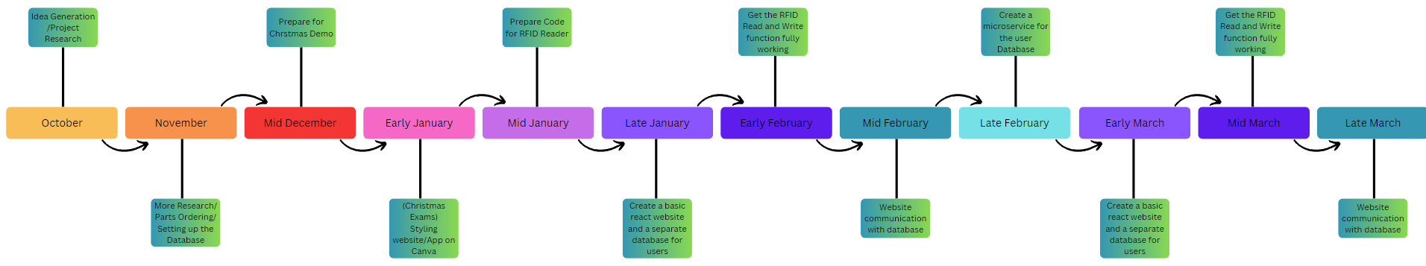
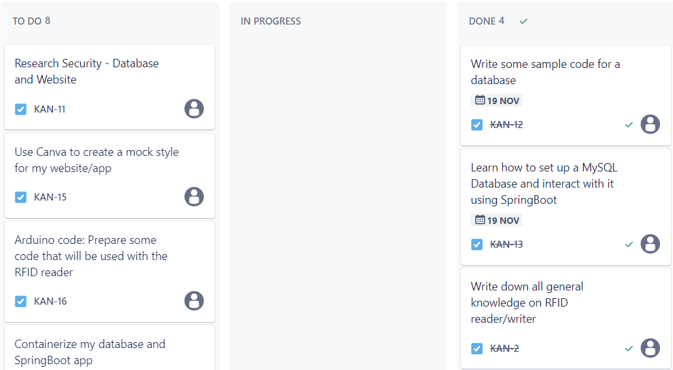

Organization
Timeline
Kanban
Github

Slide 7

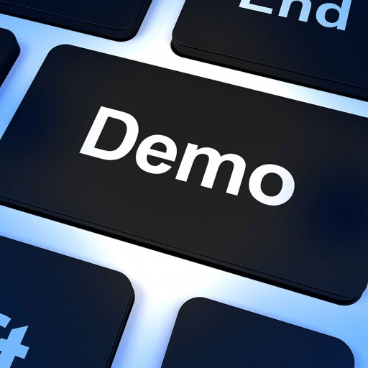
Canteen on the go
Thank You For Listening
I will now demo my project

